Slide 1

BLOCK-CHAIN BASED E-CERTIFICATION
A project by CS-Clinic
Muhammad Rafay 17B-008-SE
Muhammad Aamir 17B-034-SE
Hassan Ahmed Siddiqui 17B-049-SE
Muhammad Sabih 17B-058-SE
Muhammad Ismail 17B-062-SE
Software Engineering (SE)

Slide 2

Problems Statement
The problem is that different certificates like events, courses, health, etc. are issued to the people from different organizations. But in case of any mishaps (natural disaster, snatching, etc.) person might lose his/her certificate, Sometime the organization shift the platform so it is very difficult process to get that certificate again due to lots of hurdles, verifying those certificates is really big issue, some time it is not possible due to lack of backup and sometime if it is possible so it is very time consuming and costly process also preparing and distributing those certificates manually is so much time consuming.
Literature Based

Slide 3
Solution
We are providing a platform of blockchain based e-certification CERTIFIS which provides a way to verify the certificates not only by the certificate generating entity also by other users (either the part of any entity in the network or not) and in case any entity loss their data or change their platform then the certificates issued by them will be still verifiable.
The Blockchain based e-certification project will meet the following objectives:
• Provide distributed platform for verifiability of certificate.
• No certificate or data loss due to any mishap.
• Temper free securable environment.
Literature Based

Slide 4
Proof of Concept (POC)
Project Title:
Blockchain based E-Certification – SE02
POC:
Register two universities, publish 0 individuals, 2 batches (with 5 Certificates) for 2 different universities, show all interaction with debugging interface with Hyper Ledger Fabric. Also show formatted email messages that will receive owner and issuer, and verifier of certificates.
Project Demonstration

Slide 5
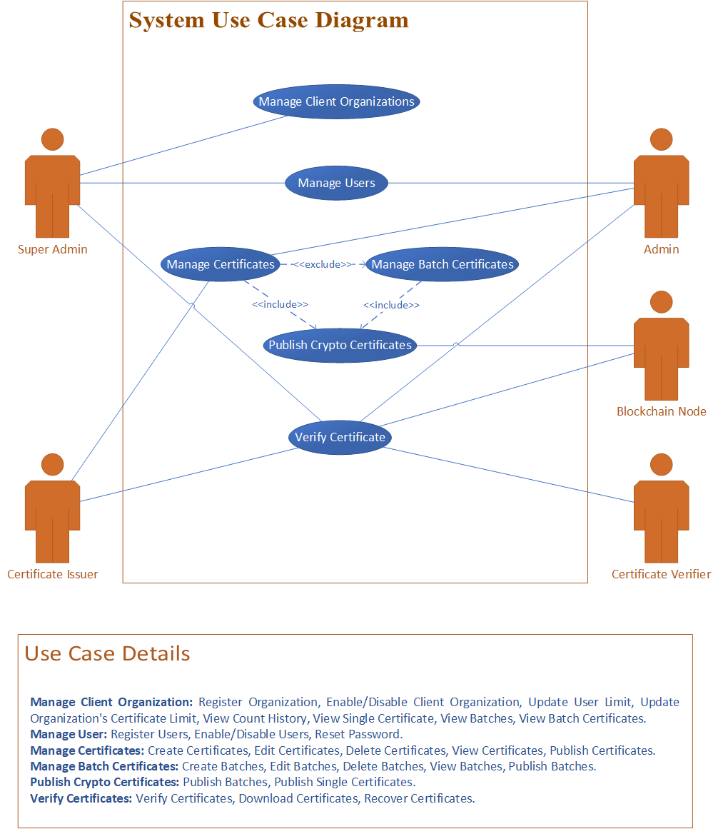
Actor Use-Case Diagram
Use-Case

Slide 6
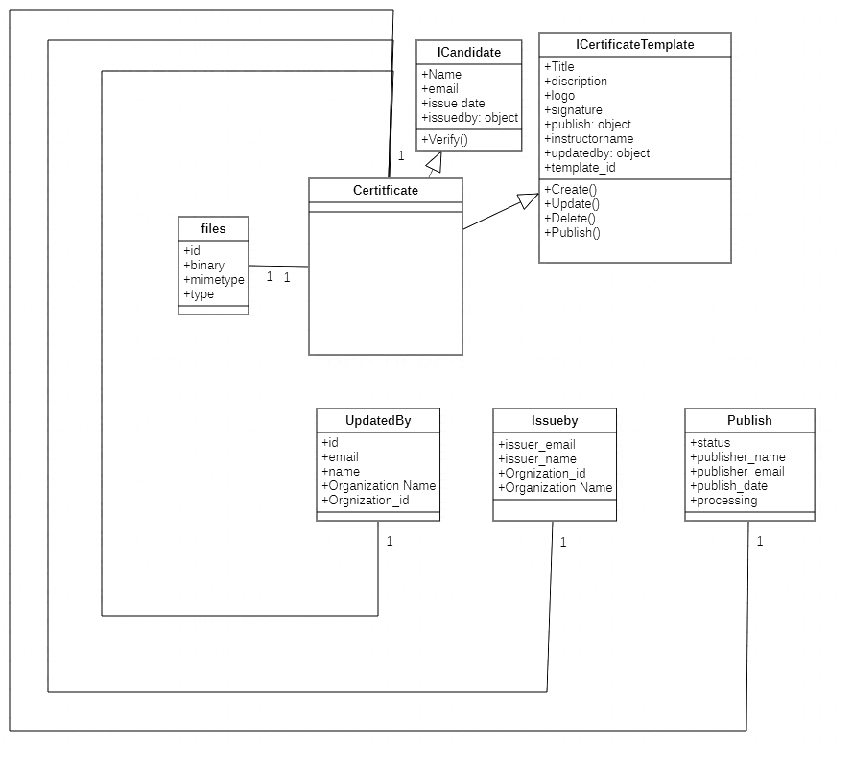
Manage Certificate Class Diagram

Slide 7
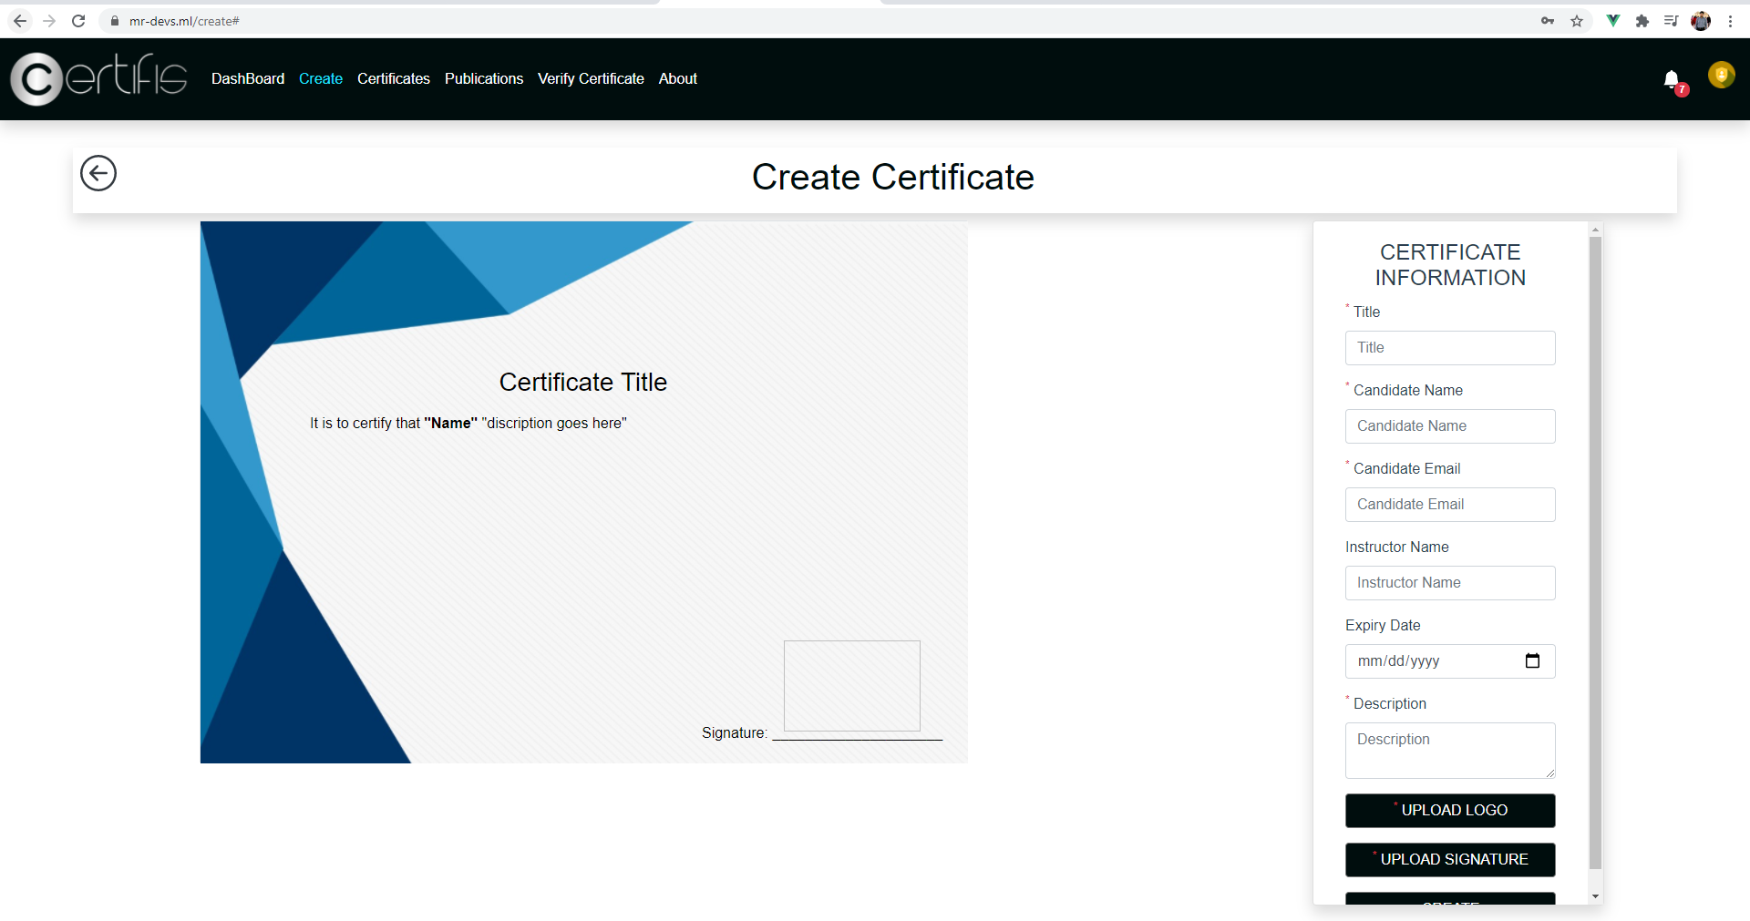
Manage Certificate Front ends(Interfaces)

Slide 8
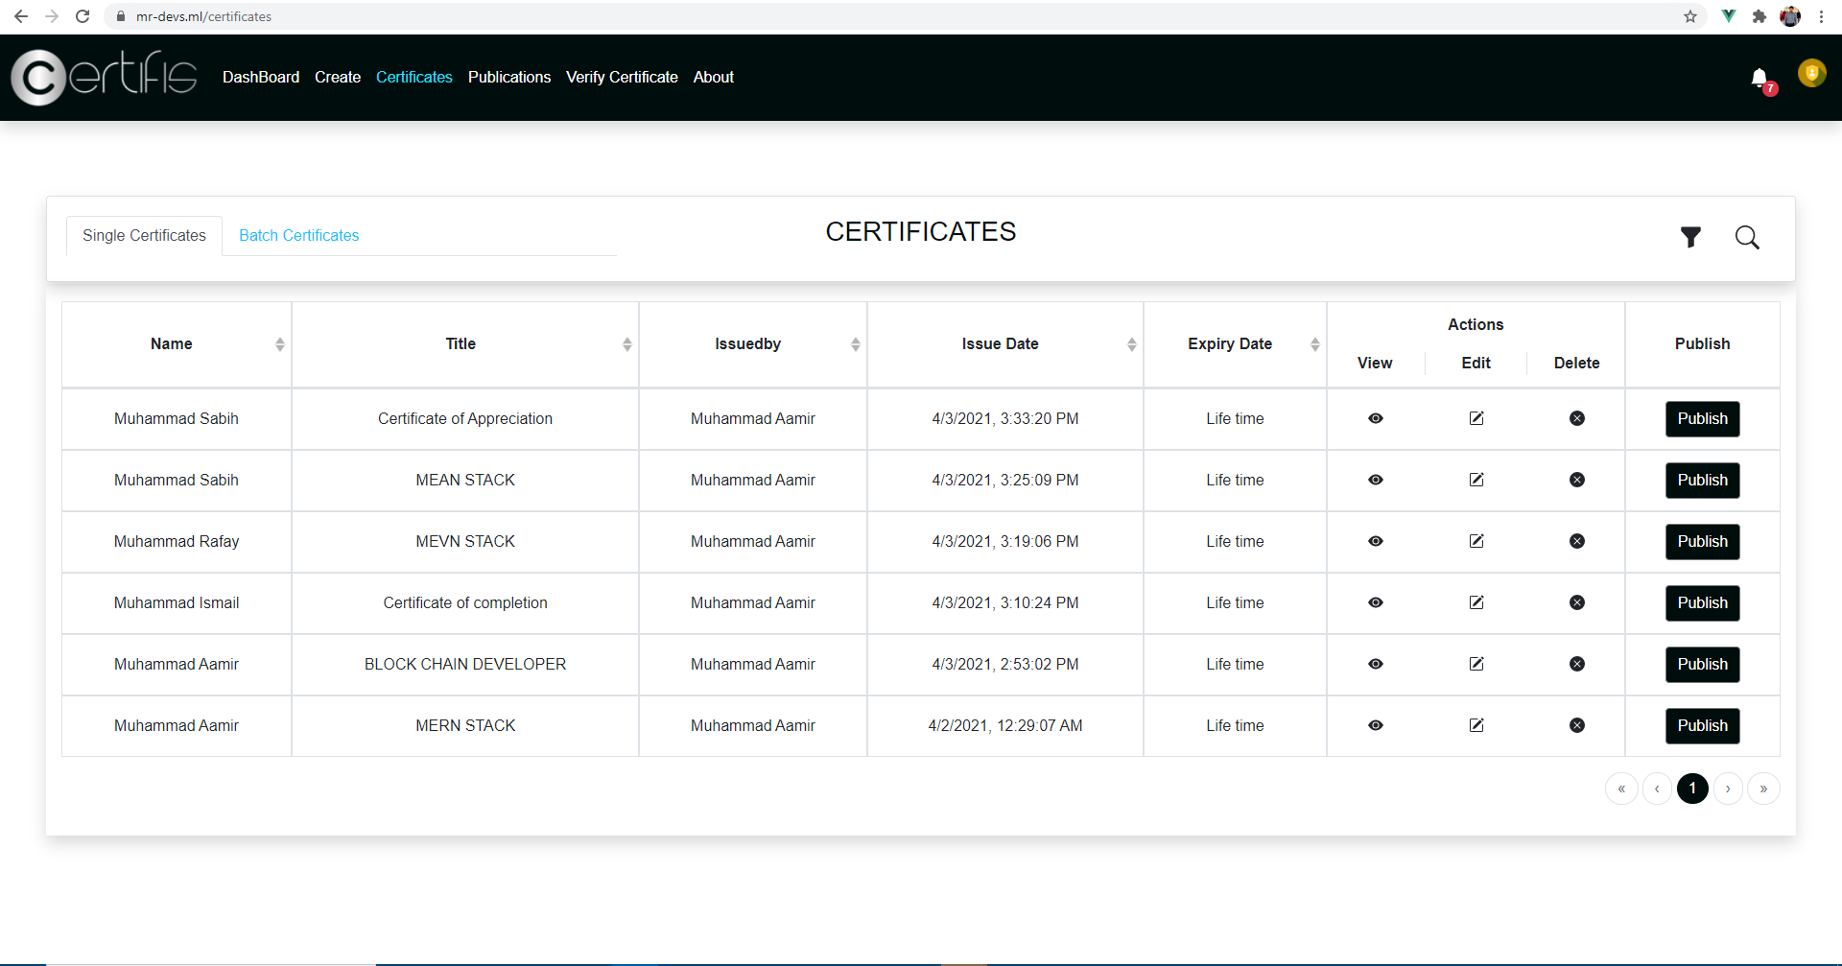
Manage Certificate Front ends(Interfaces)

Slide 9
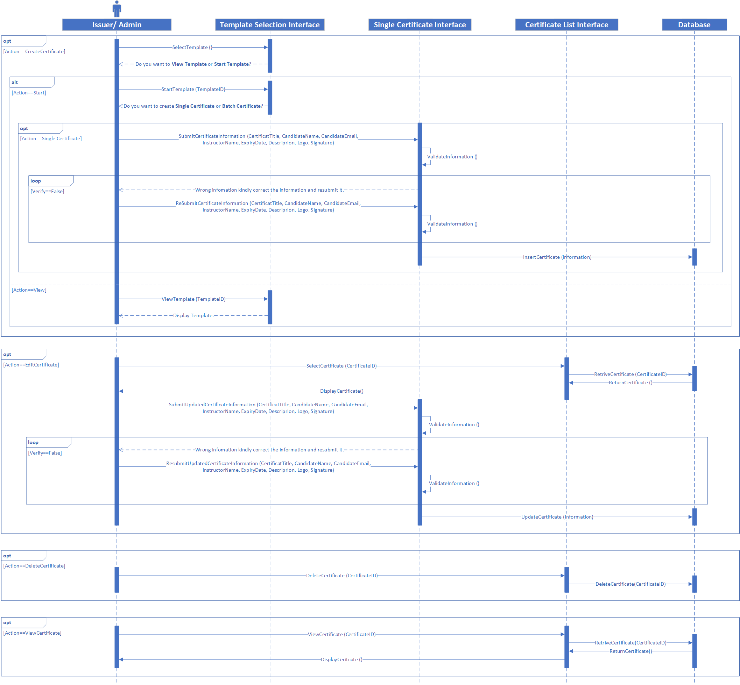
Manage Certificate Sequence Diagram

Slide 10
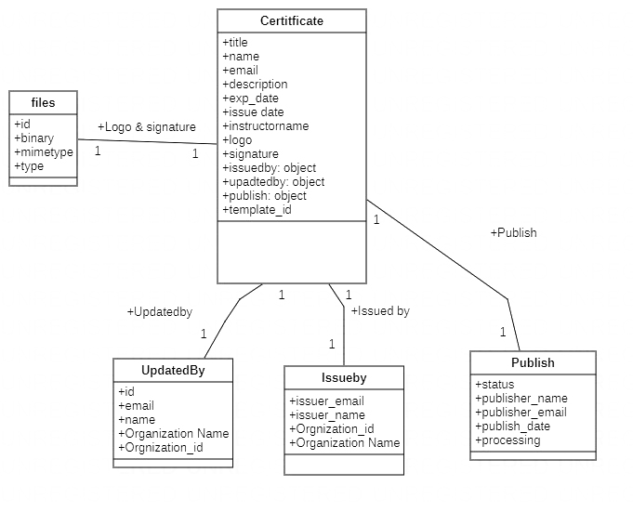
Manage Certificate Object Diagram

Slide 11
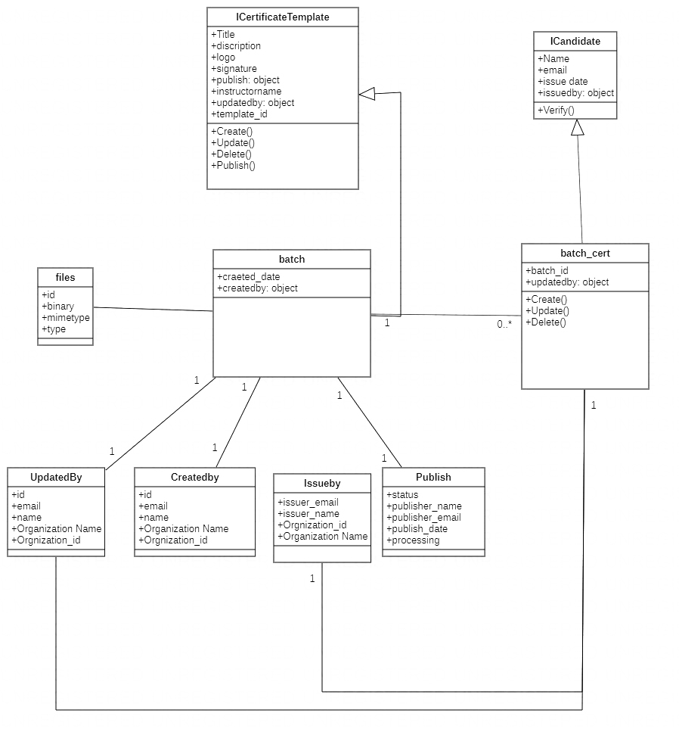
Manage Batch Certificate Class Diagram

Slide 12
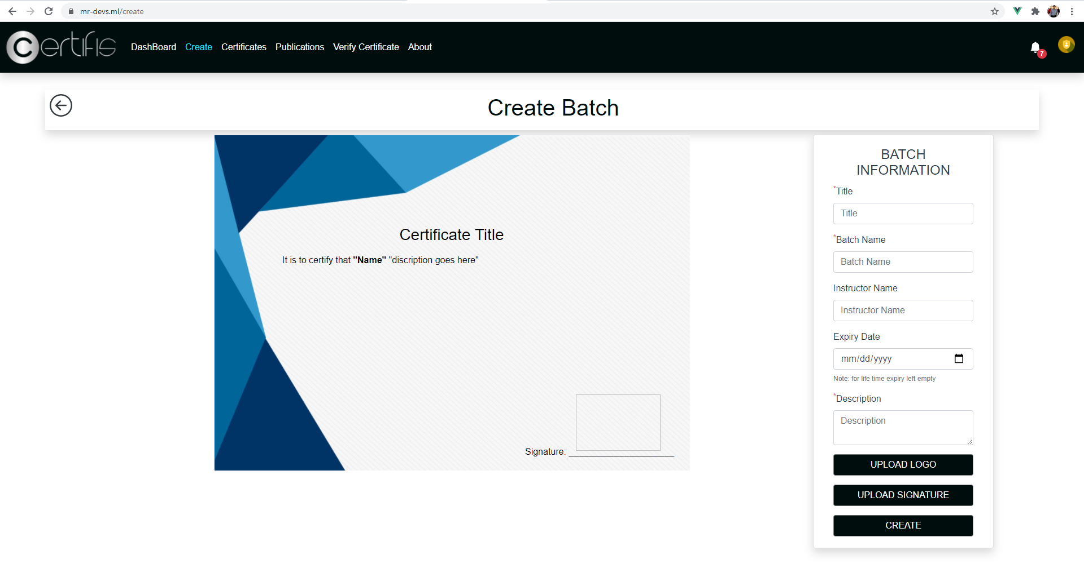
Manage Batch Certificate Front ends(Interfaces)

Slide 13
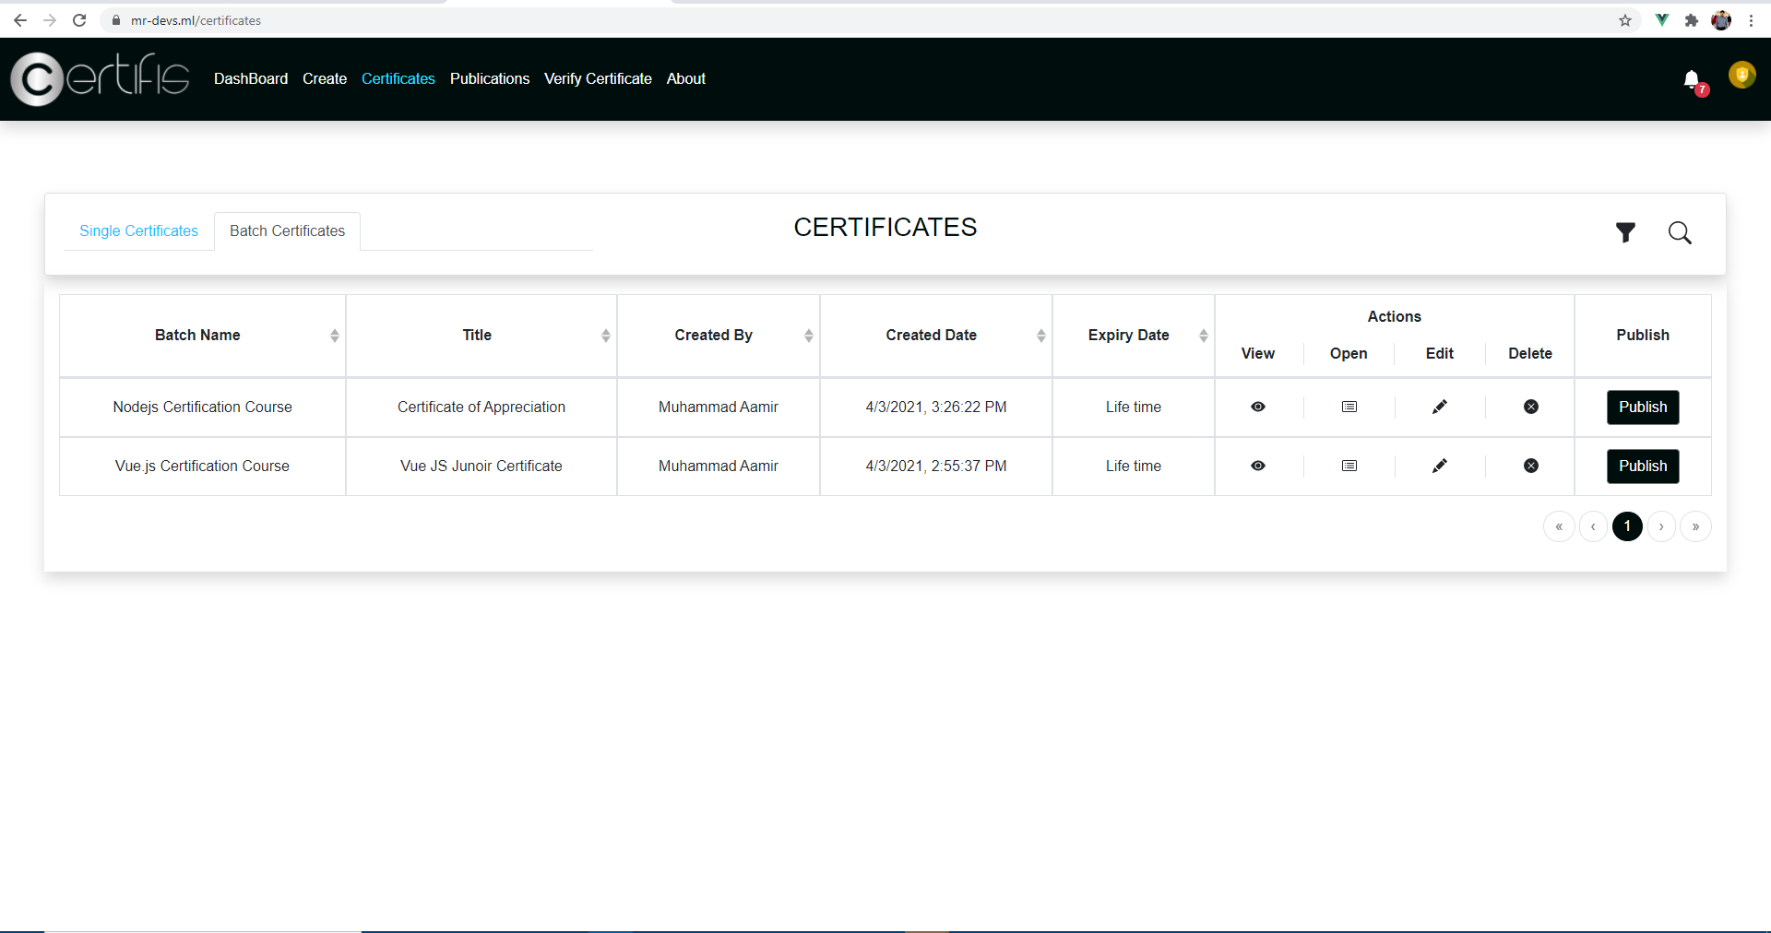
Manage Batch Certificate Front ends(Interfaces)

Slide 14
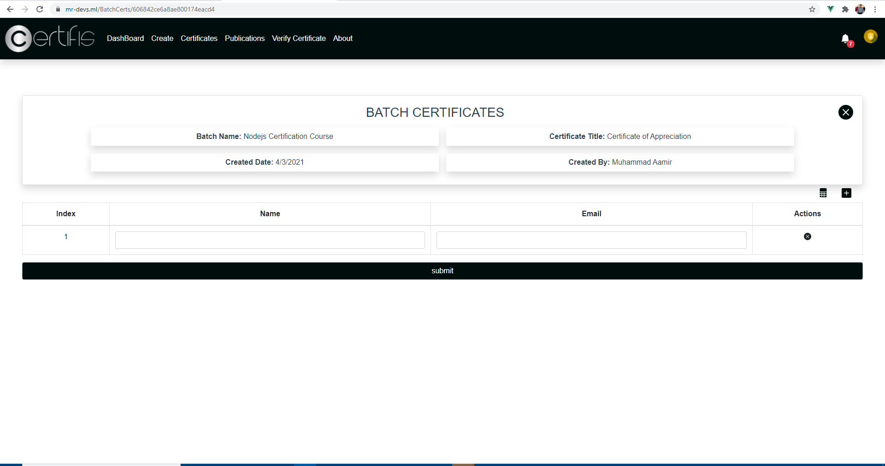
Manage Batch Certificate Front ends(Interfaces)

Slide 15
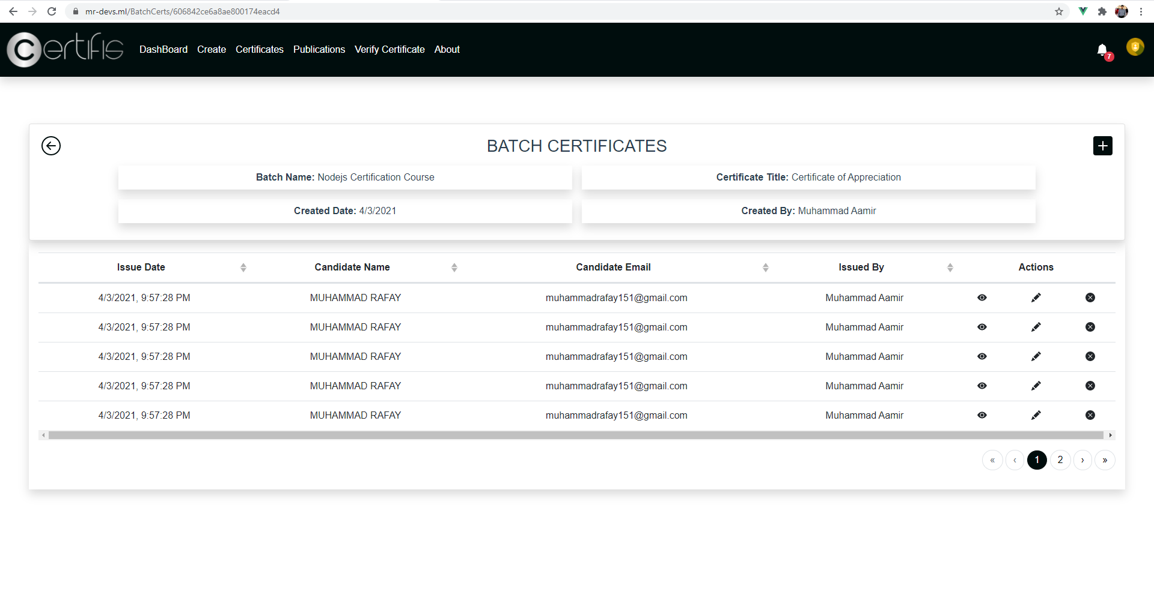
Manage Batch Certificate Front ends(Interfaces)

Slide 16
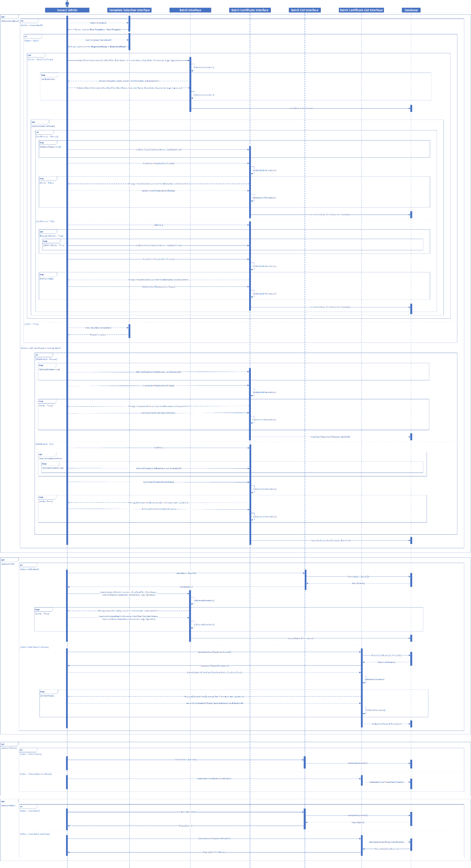
Manage Batch Certificate Sequence Diagram

Slide 17
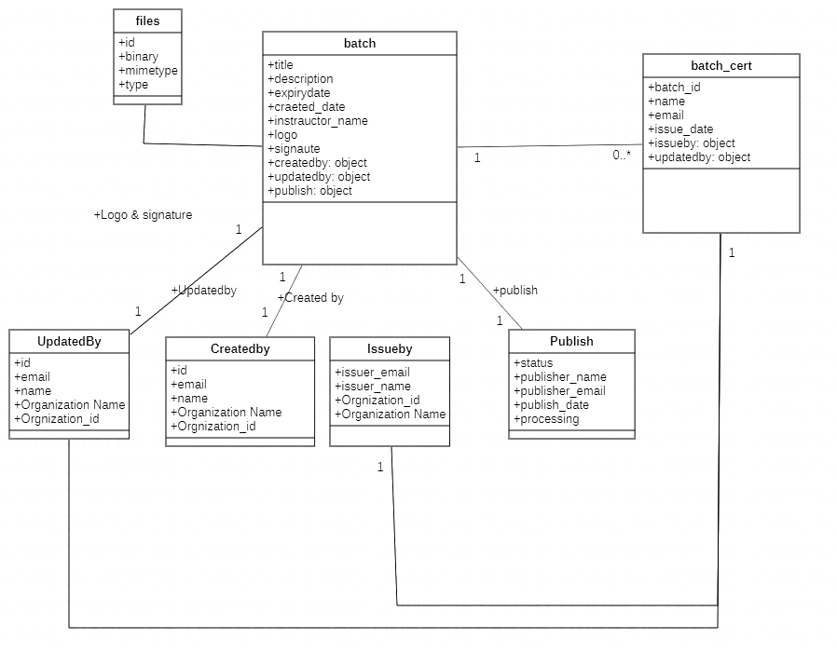
Manage Batch Certificate Object Diagram

Slide 18
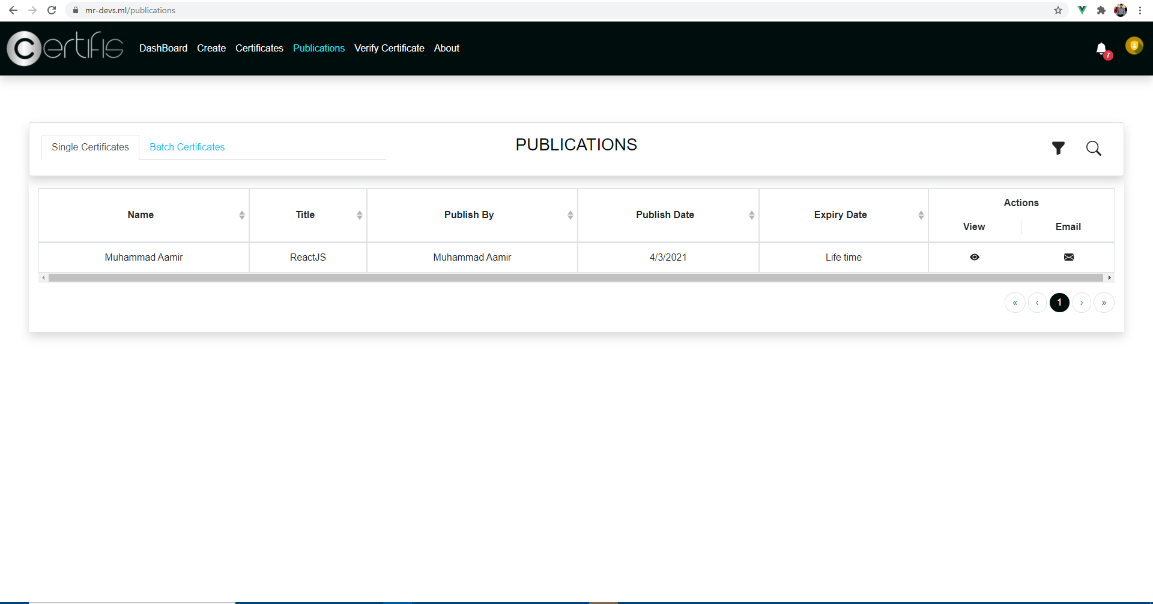
Publish Crypto Certificate Front ends(Interfaces)

Slide 19
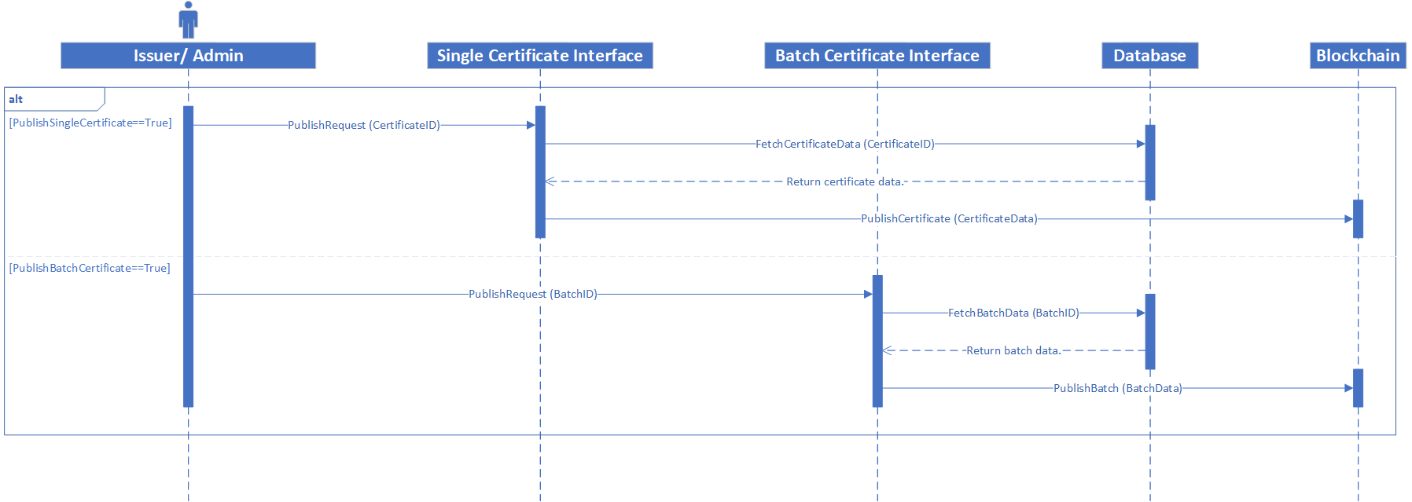
Publish Crypto Certificate Sequence Diagram

Slide 20
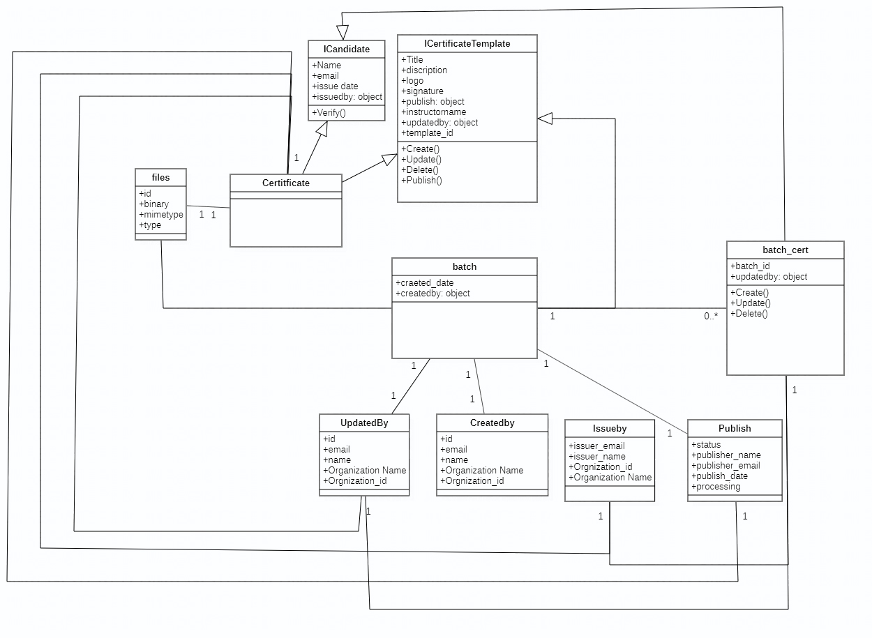
Verify Certificate Class Diagram

Slide 21
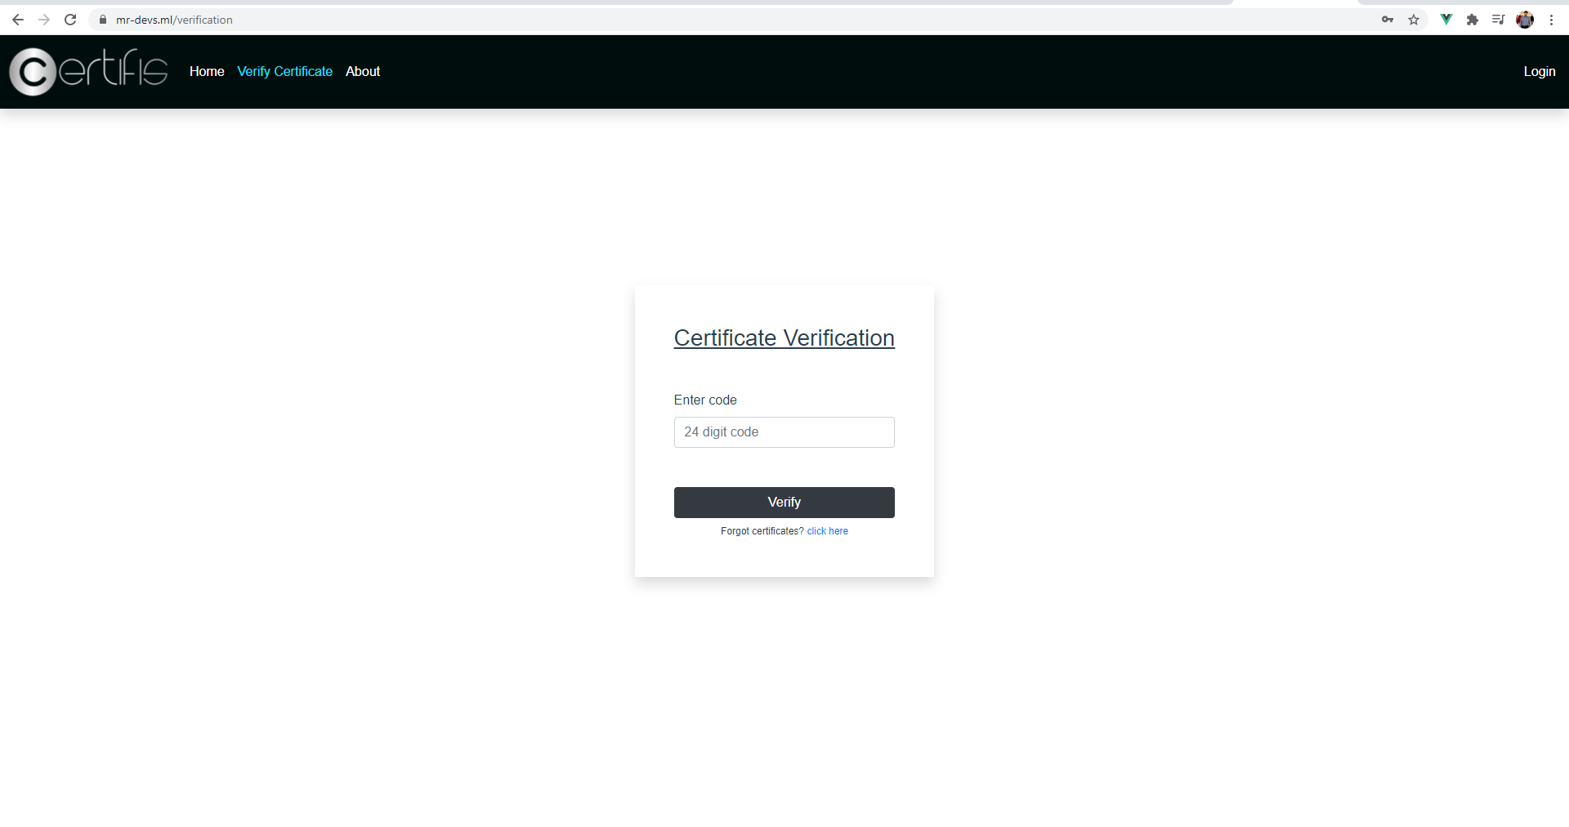
Verify Certificate Front ends(Interfaces)

Slide 22
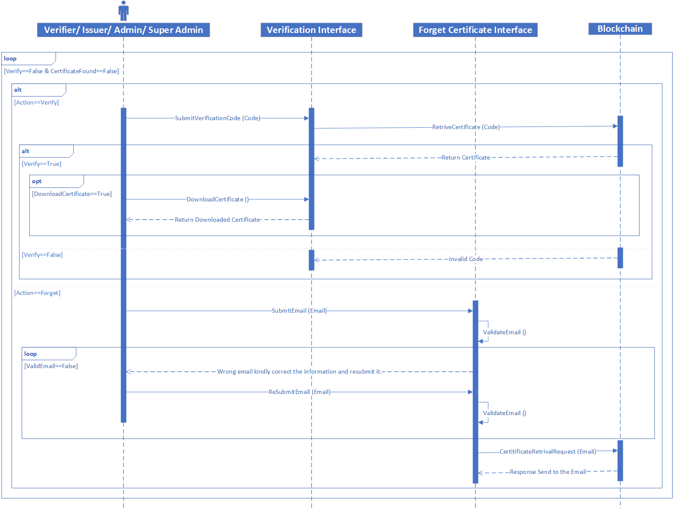
Verify Certificate Sequence Diagram

Slide 23
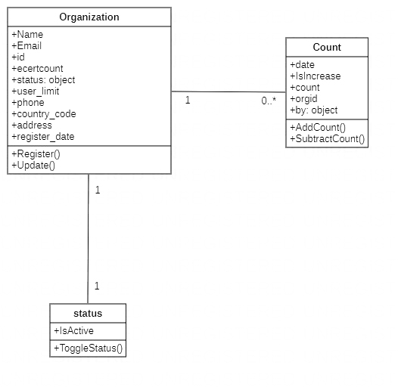
Manage Client Organization Class Diagram

Slide 24
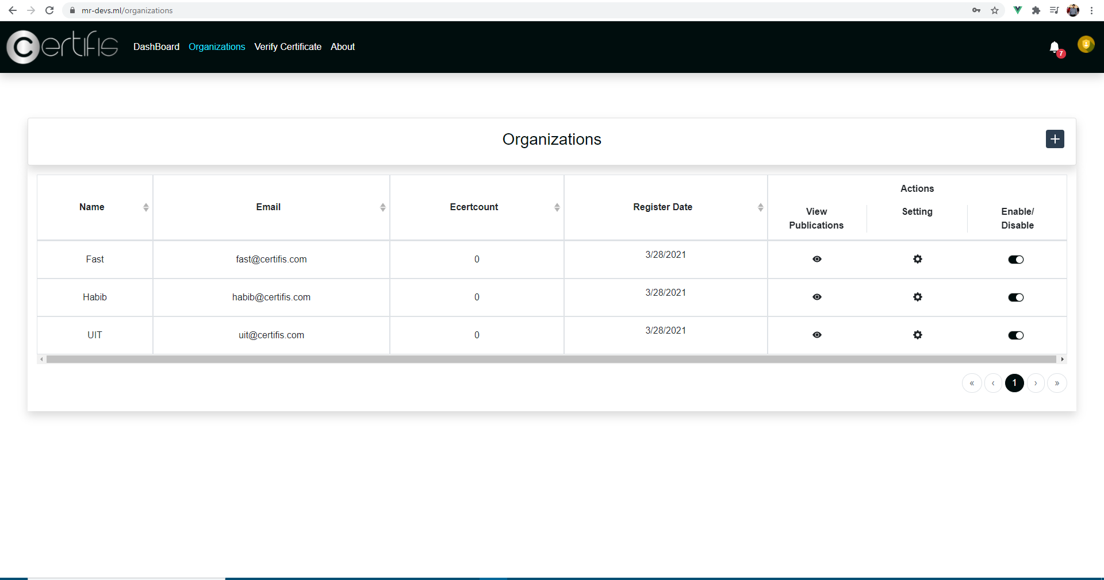
Manage Client Organization Front ends (Interfaces)

Slide 25
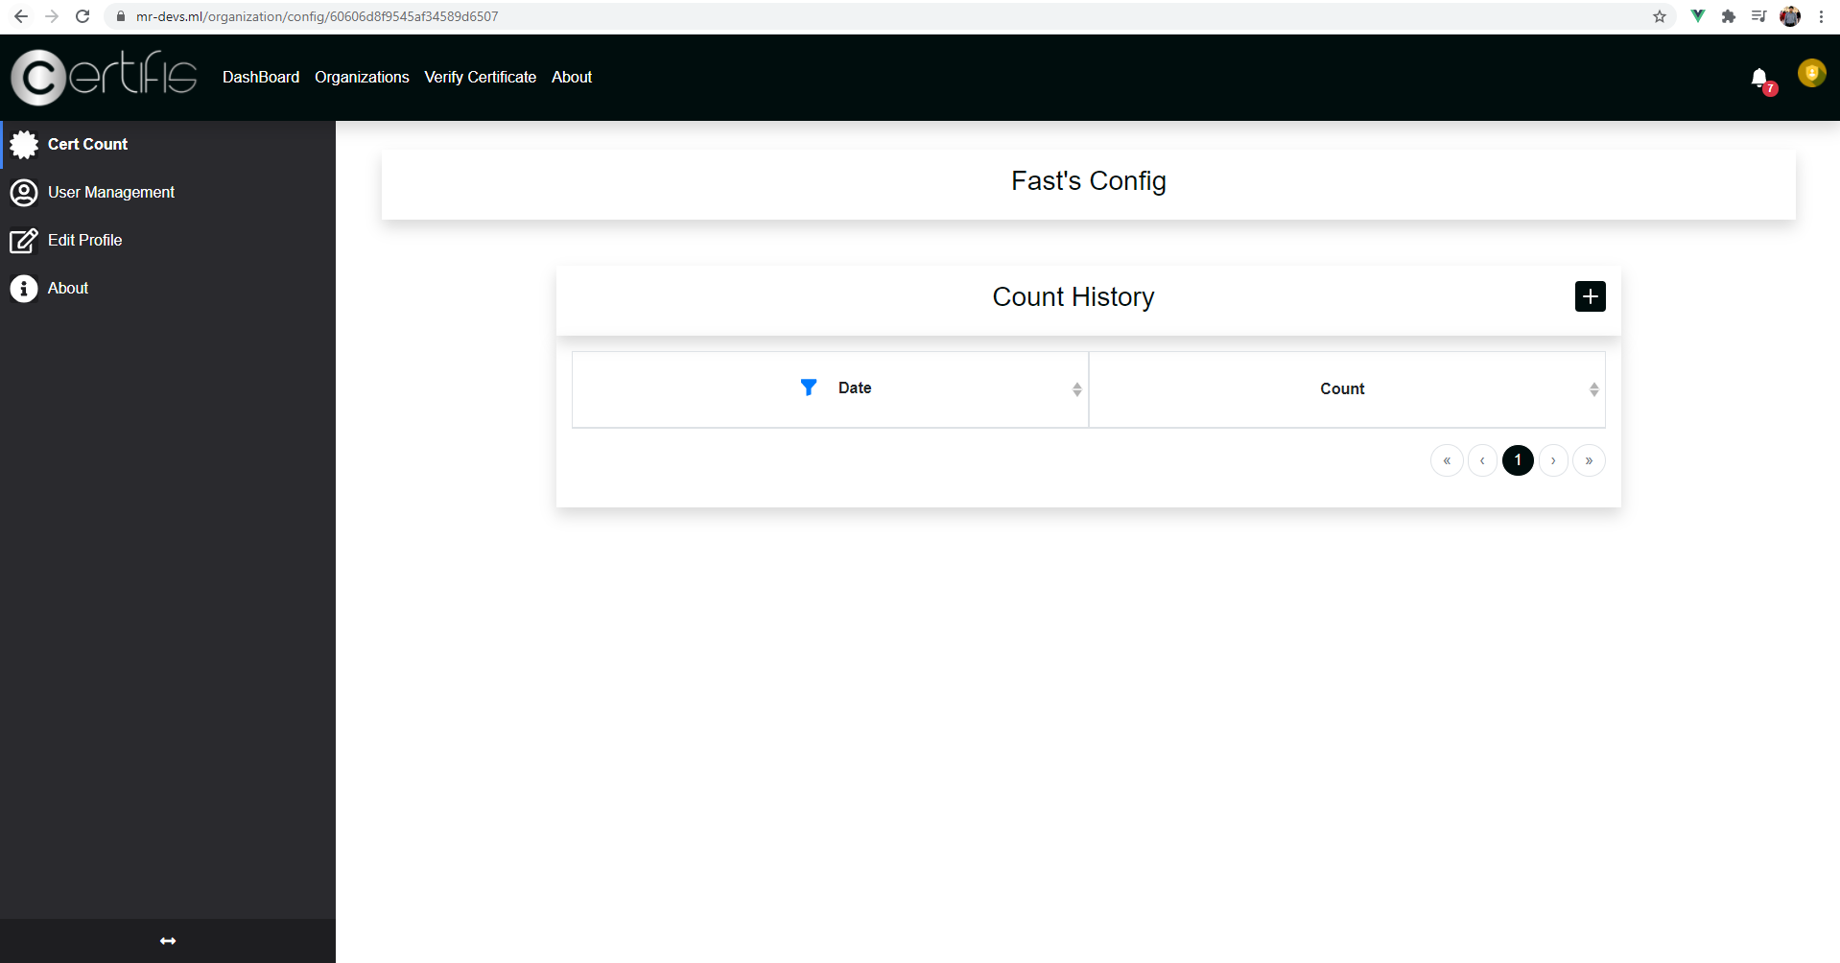
Manage Client Organization Front ends (Interfaces)

Slide 26
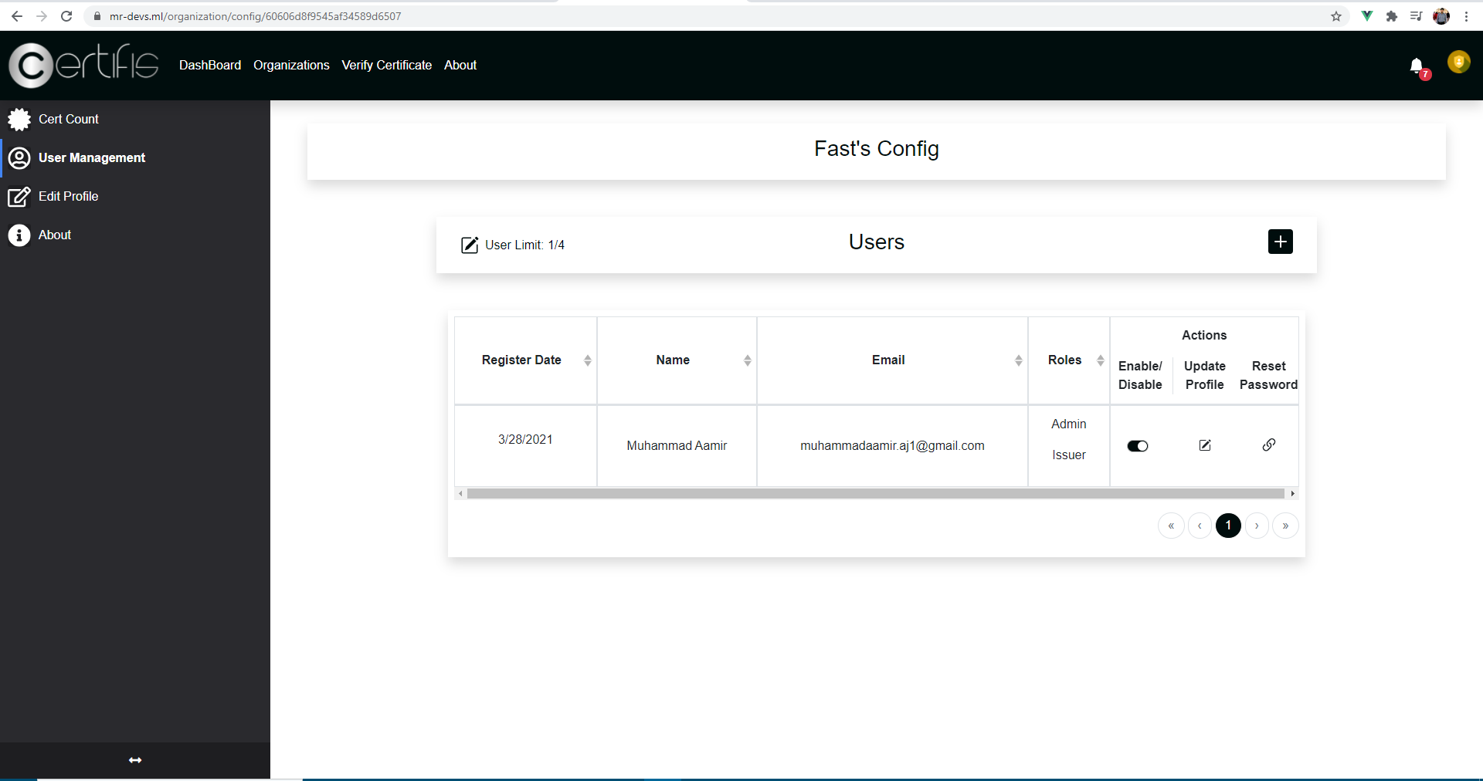
Manage Client Organization Front ends (Interfaces)

Slide 27
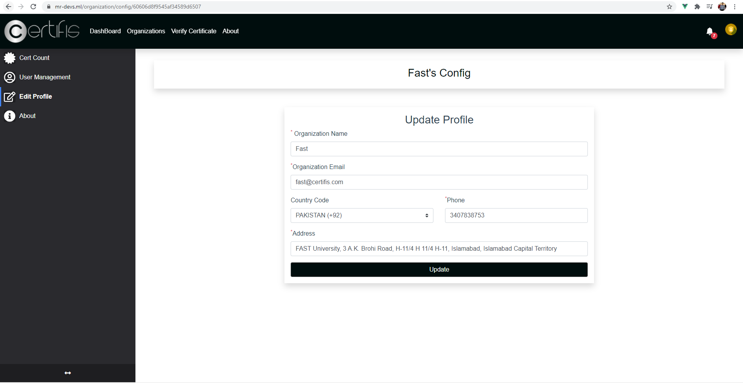
Manage Client Organization Front ends (Interfaces)

Slide 28
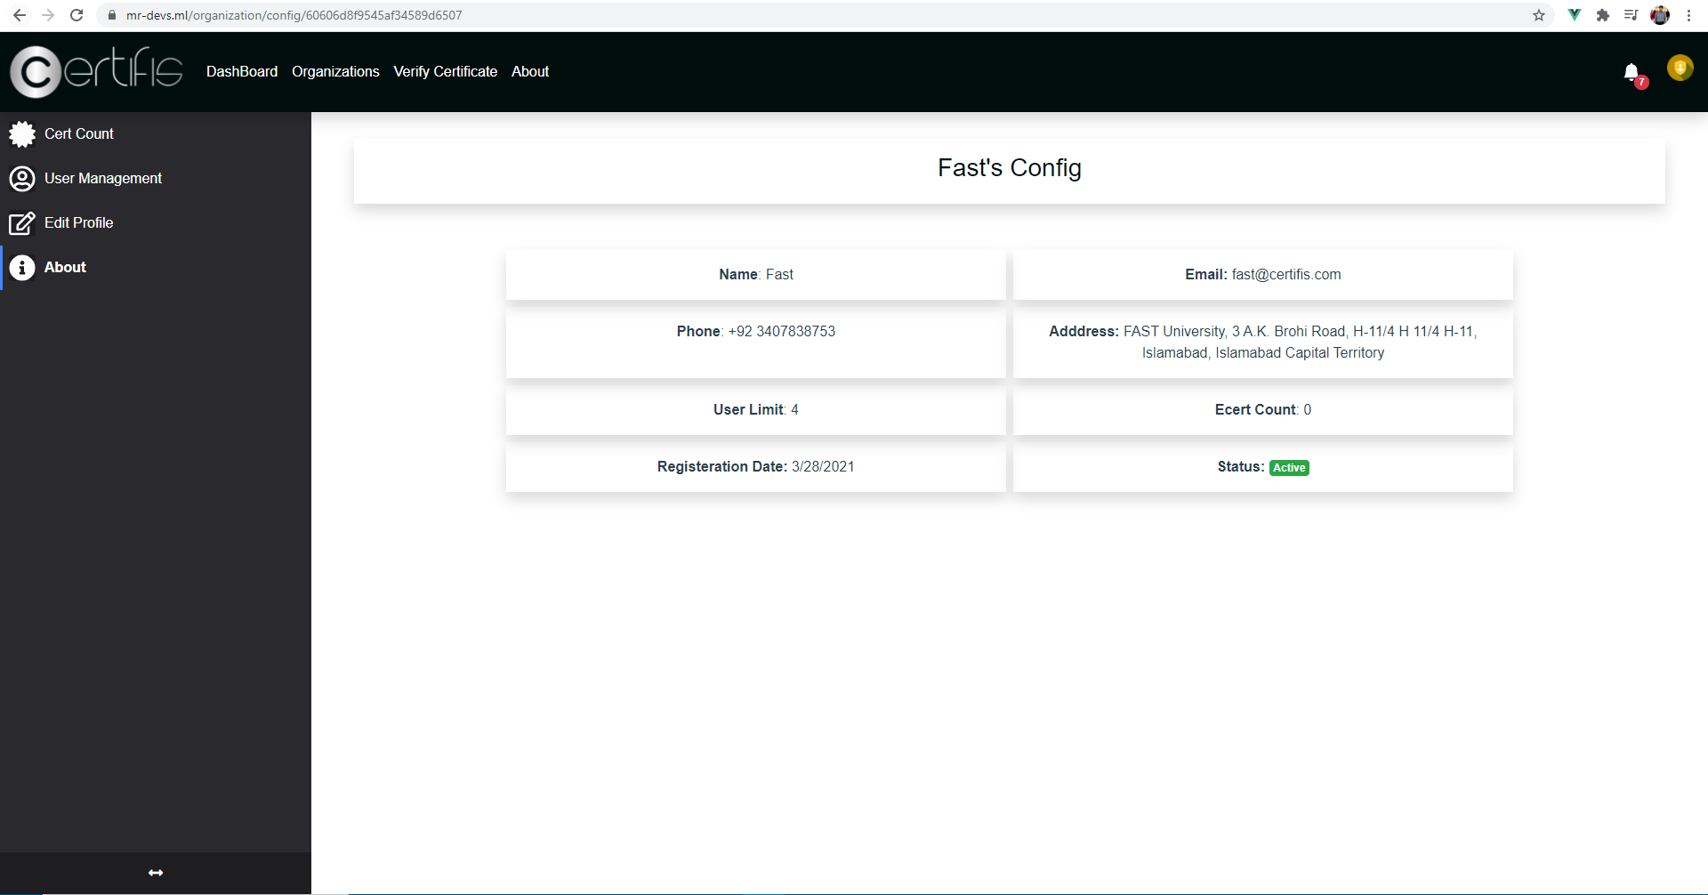
Manage Client Organization Front ends (Interfaces)

Slide 29
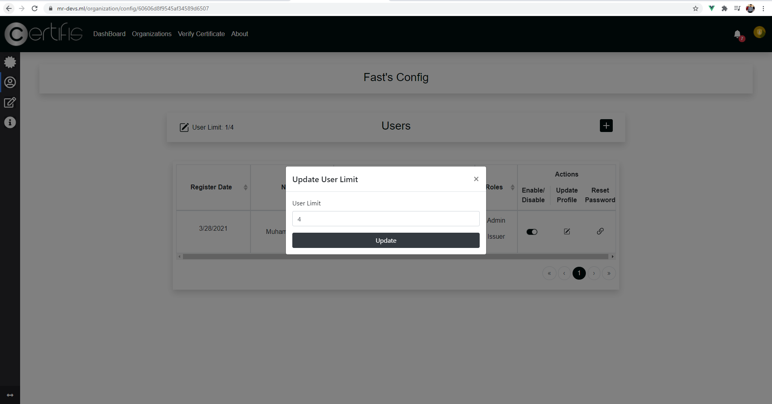
Manage Client Organization Front ends (Interfaces)

Slide 30
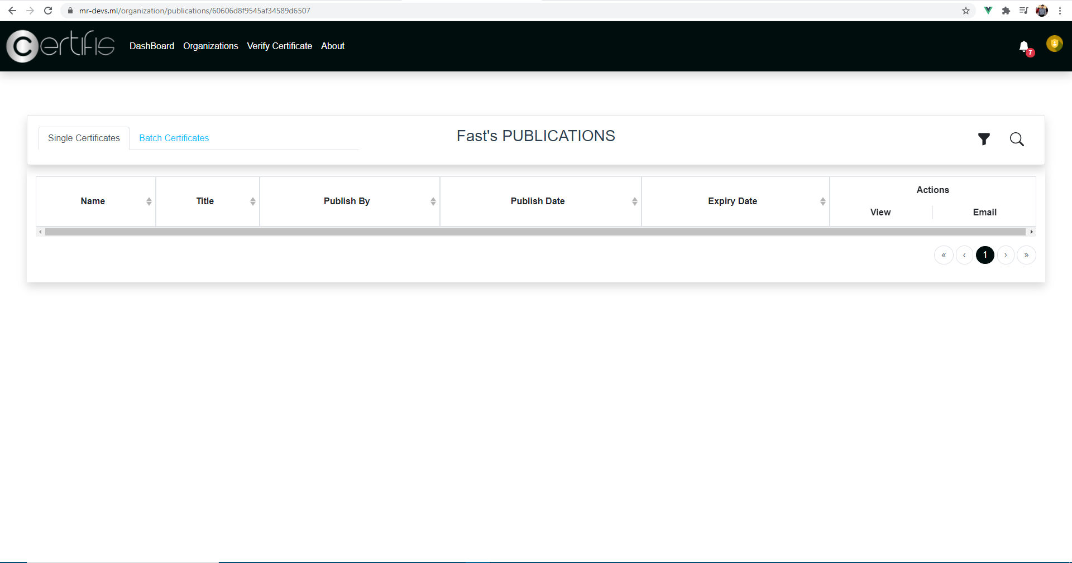
Manage Client Organization Front ends (Interfaces)

Slide 31
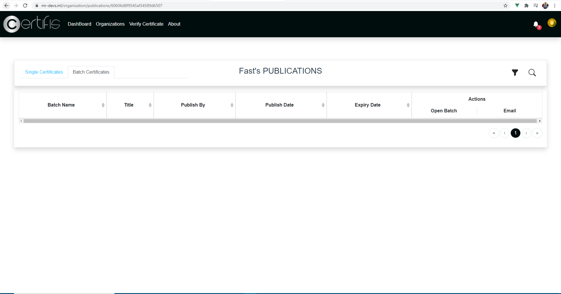
Manage Client Organization Front ends (Interfaces)

Slide 32
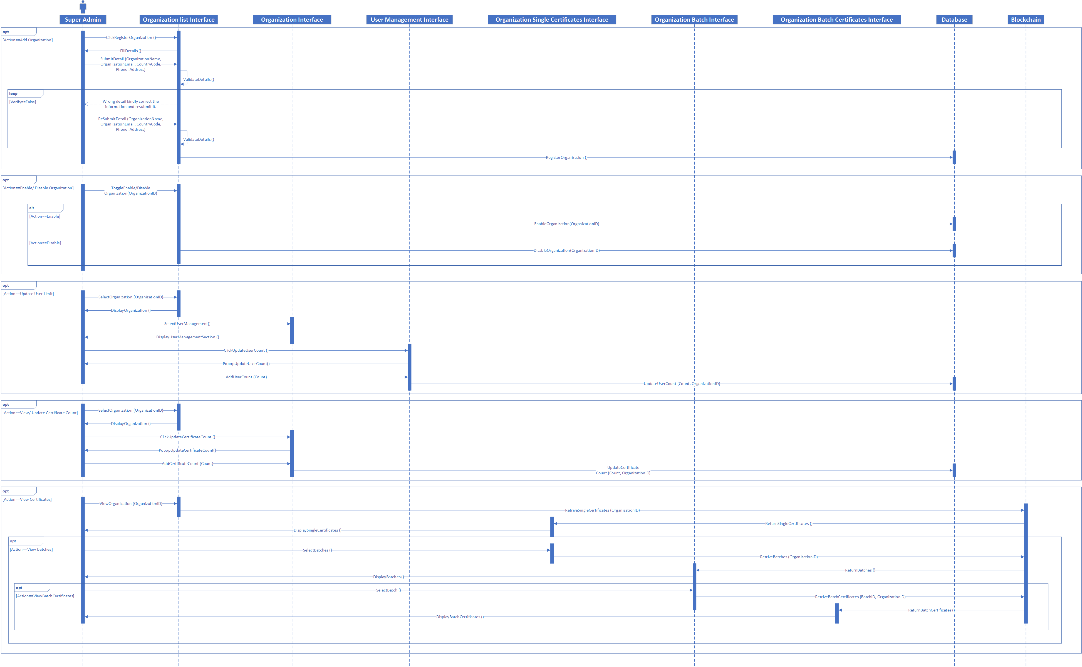
Manage Client Organization Sequence Diagram

Slide 33
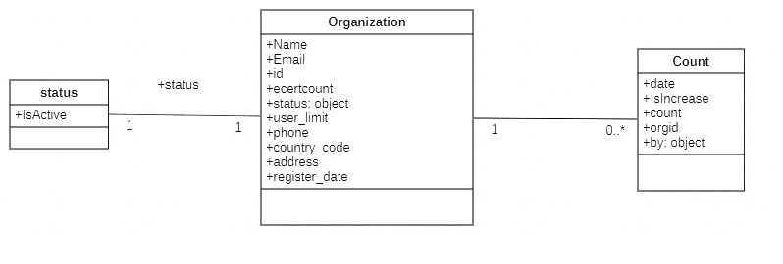
Manage Client Organization Object Diagram

Slide 34
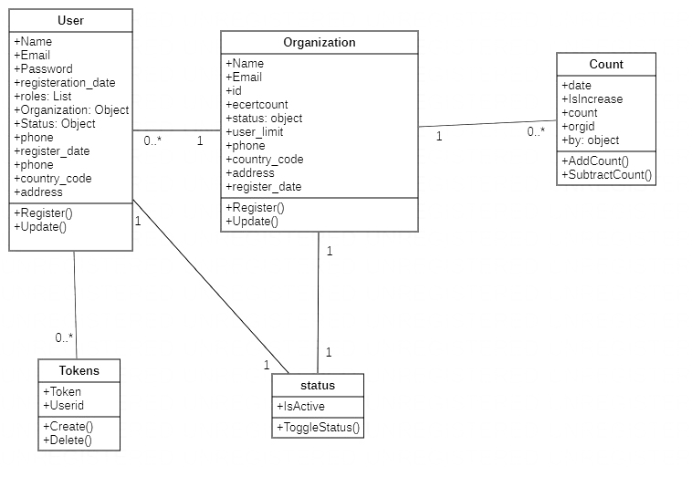
Manage User Class Diagram

Slide 35
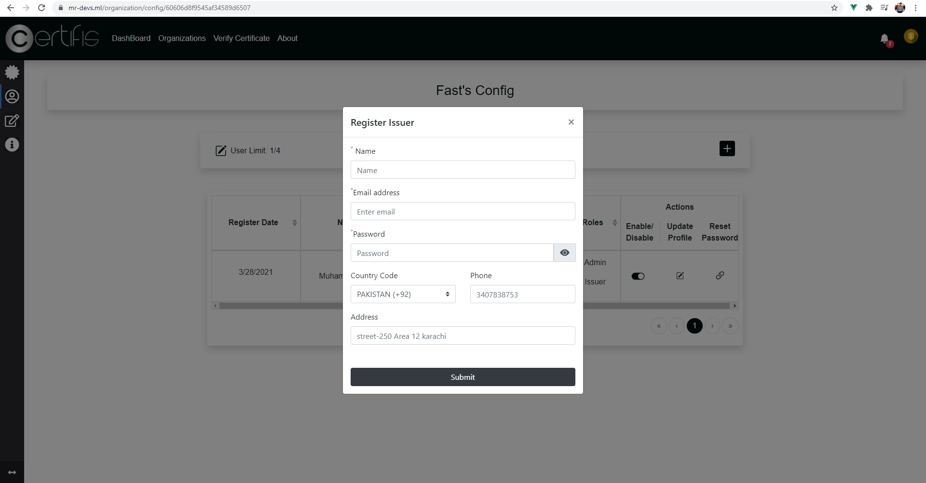
Manage User Front Ends(Interface)

Slide 36
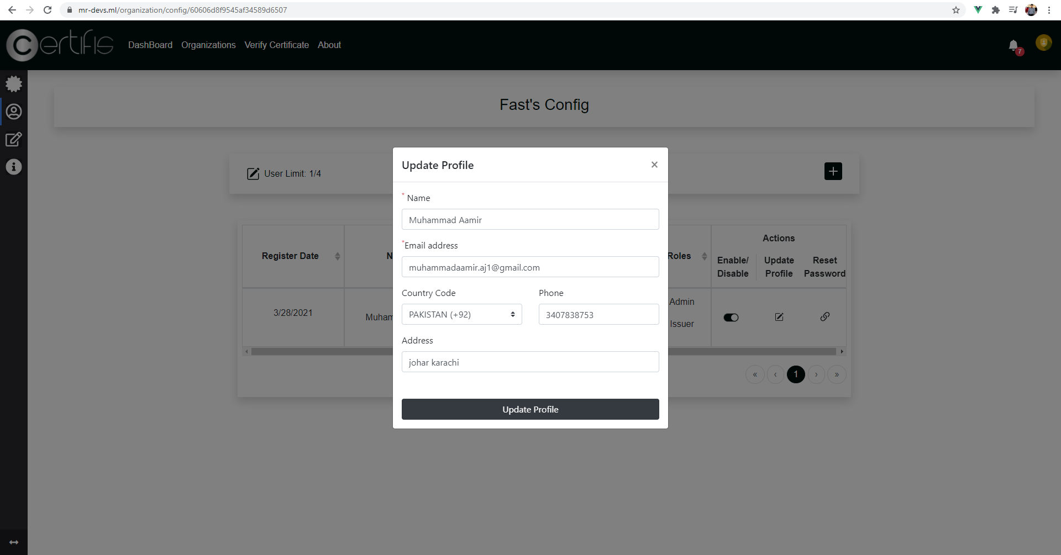
Manage User Front Ends(Interface)

Slide 37
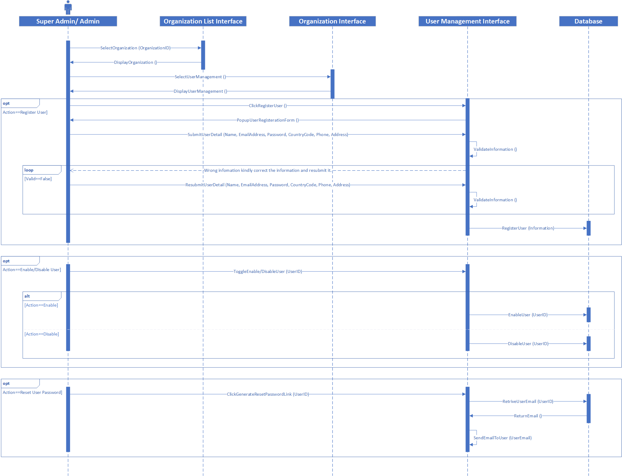
Manage User Sequence Diagram

Slide 38
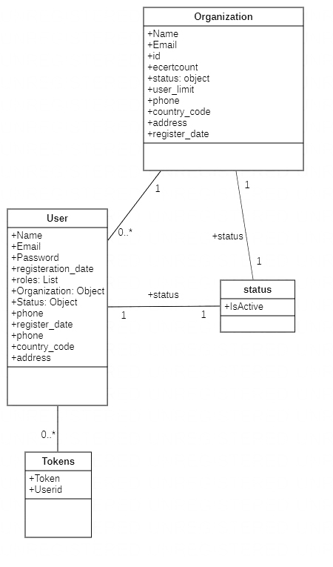
Manage User Object Diagram

Slide 39
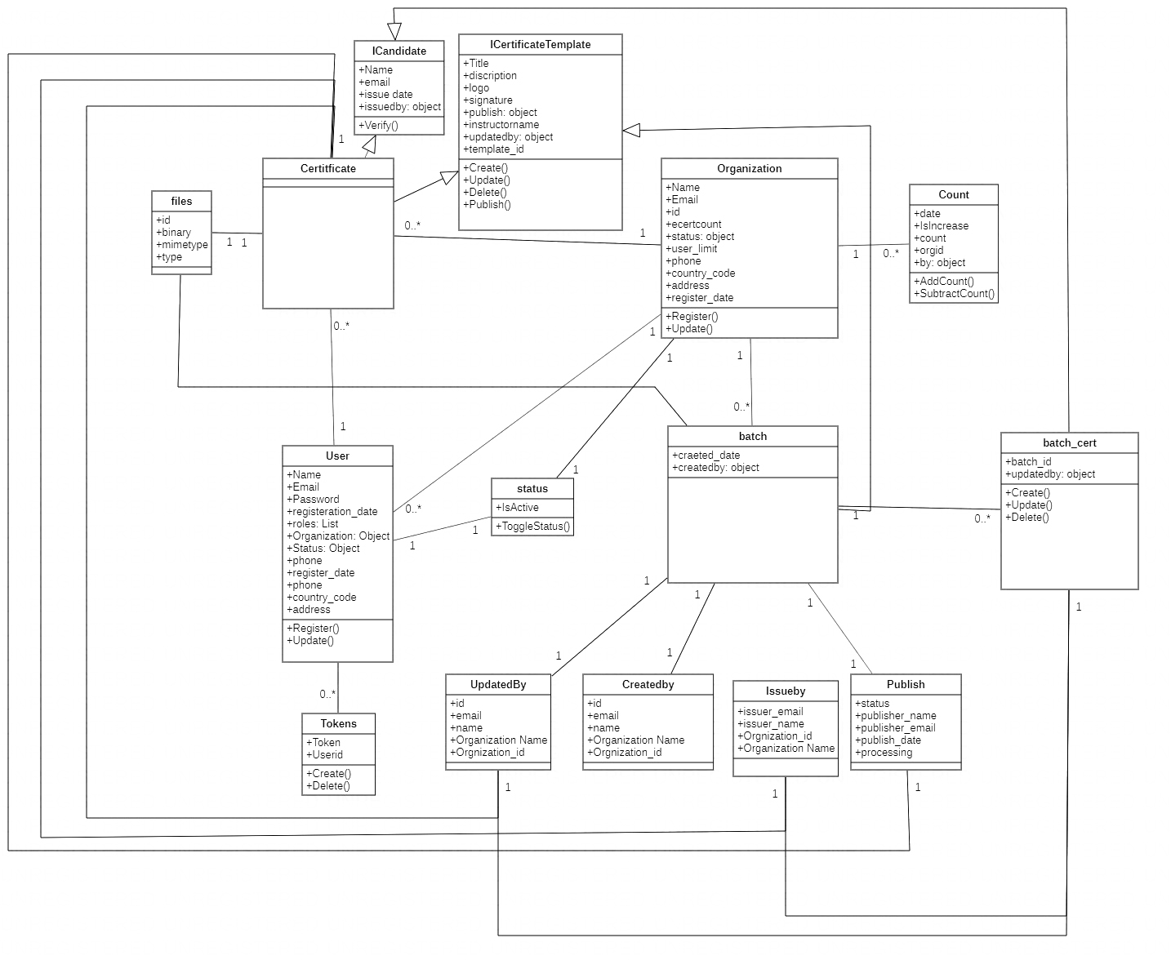
Class Diagram of the project

Slide 40
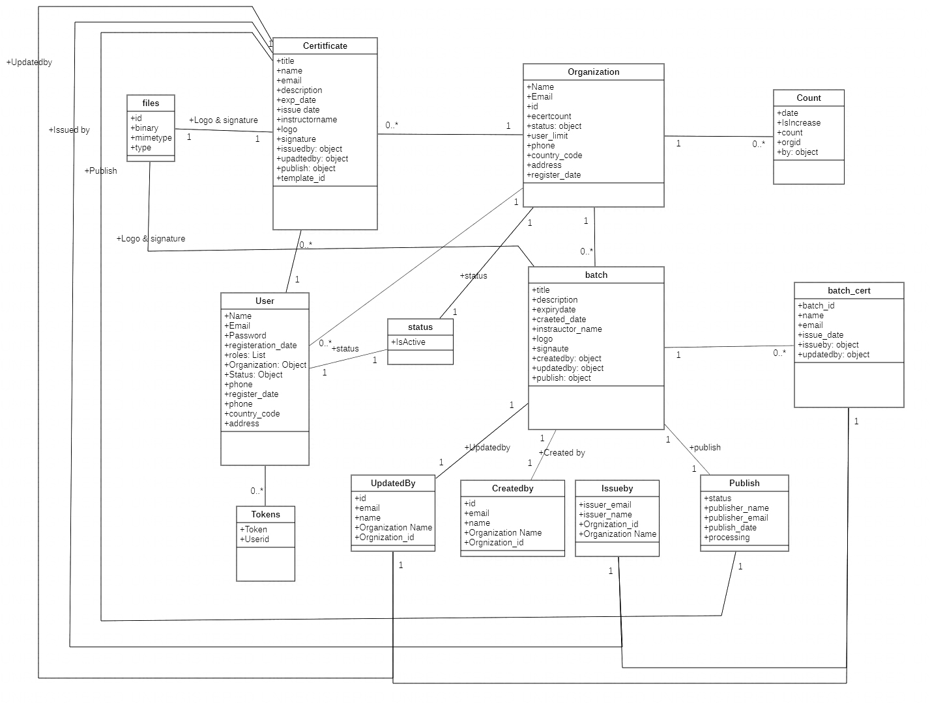
Database Diagram of the project

